Slide 1

Introduction to TinyML, TensorflowLite and Edge Impulse

Slide 2
TinyML

Slide 3
What is TinyML
TinyML is a type of machine learning that shrinks deep learning networks to fit on tiny hardware.
It brings together Artificial Intelligence and intelligent devices.

Slide 4
What is TinyML
TinyML is a field of study in Machine Learning and Embedded Systems that explores the types of models you can run on small, low-powered devices like microcontrollers.
It enables low-latency, low power and low bandwidth model inference at edge devices.

Slide 5
What is TinyML
While a standard CPUs consume between 65 watts and 85 watts and standard GPU consumes anywhere between 200 watts to 500 watts,
A typical microcontroller consumes power in the order of milliwatts or microwatts.

Slide 6
Advantages of TinyML?
Low Latency: Since the model runs on the edge, the data doesn't have to be sent to a server to run inference. This reduces the latency of the output.
Low Power Consumption: As we discussed before, microcontrollers consume very little power. This enables them to run without being charged for a really long time.
Low Bandwidth: As the data doesn’t have to be sent to the server constantly, less internet bandwidth is used.
Privacy: Since the model is running on the edge, your data is not stored in any servers.

Slide 7
How to use TinyML?
It uses Edge-Impulse as development and deployment framework.
For optimized Deep learning libraries, it used Tensorflow Lite.
Many tools and architectures deployed in traditional machine learning workflows are used when building edge-device applications. The main difference is that TinyML allows these models to perform various functions on smaller devices.
Tensorflow Lite for microcontrollers (TF Lite Micro) is one of the most popular frameworks for machine learning on edge devices; it was specifically designed for the task of implementing machine learning on embedded systems with only a few kilobytes of memory.
Python is often the preferred language for building machine learning models. However, TensorFlow Lite makes it possible to easily develop models in C, C++, or Java and deploy them without connecting to the internet.

Slide 8
TensorFlow Lite

Slide 9
What is TensorFlow Lite?
TensorFlow Lite is a companion project to TensorFlow, Google’s open-source project designed to bring machine learning to everyone.
It’s designed for smartphones and Linux-grade devices like the Raspberry Pi.
It’s now deployed on over two billion mobile devices in production.

Slide 10
What is TensorFlow Lite?
TensorFlow Lite is a set of tools that helps developers run TensorFlow machine learning models on mobile, embedded, and Internet of Things (IoT) devices.
It enables device machine learning with low latency and a smaller binary volume.

Slide 11
What is TensorFlow Lite?
It enables on-device machine learning inference with low latency and a small binary size
Low latency techniques: optimizing the kernels for mobile apps, pre-fused activations, and quantized kernels that allow smaller and faster (ﬁxed-point math) models
TensorFlow Lite also supports hardware acceleration with the Android Neural Networks API

Slide 12
What is TensorFlow Lite for Microcontrollers?
Even a few hundred kilobytes is too large for most embedded systems.
If we want to run on MCUs, we need:
Low tens of kilobytes code footprint.
No operating system dependencies.
No dynamic memory allocation.
We managed to create a version of TensorFlow Lite that meets these constraints, sharing most of the same code, but with only a 20 kilobyte footprint.

Slide 13
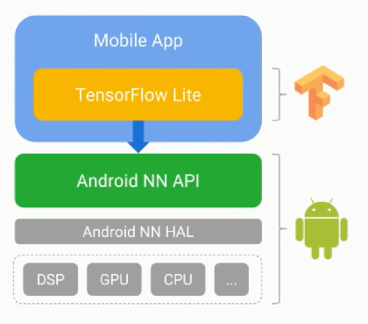
tf-lite and android NN
New TensorFlow runtime
Optimized for mobile and
embedded apps
Runs TensorFlow models on device
Leverage Android NN API

Slide 14
EDGE IMPULSE

Slide 15
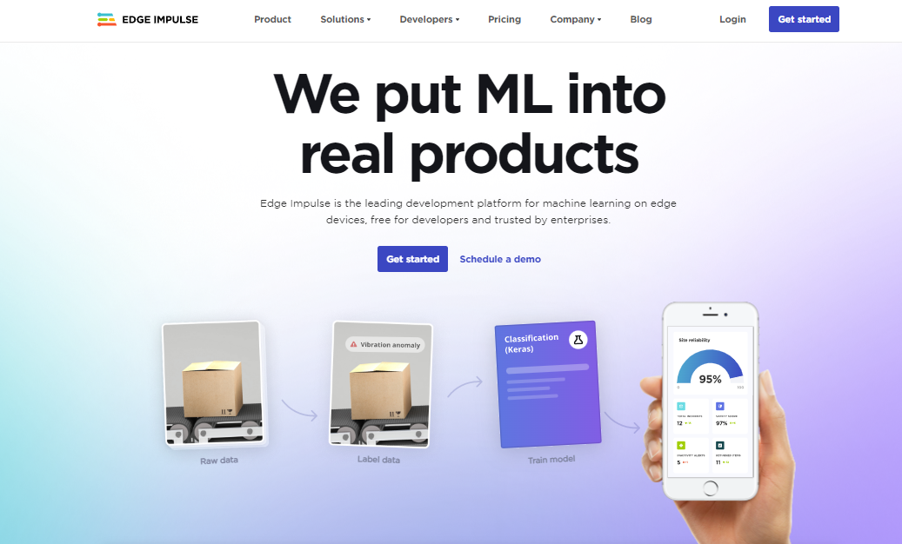
EDGE IMPULSE
Notes:
Fgfg df

Slide 16
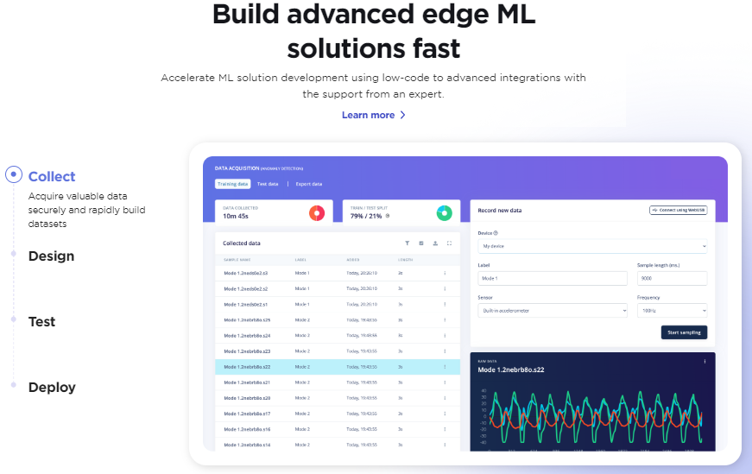
EDGE IMPULSE

Slide 17
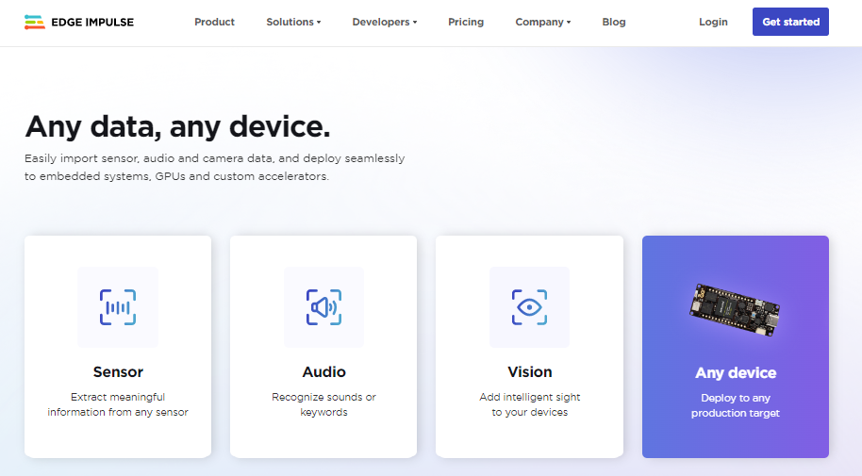
EDGE IMPULSE

Slide 18
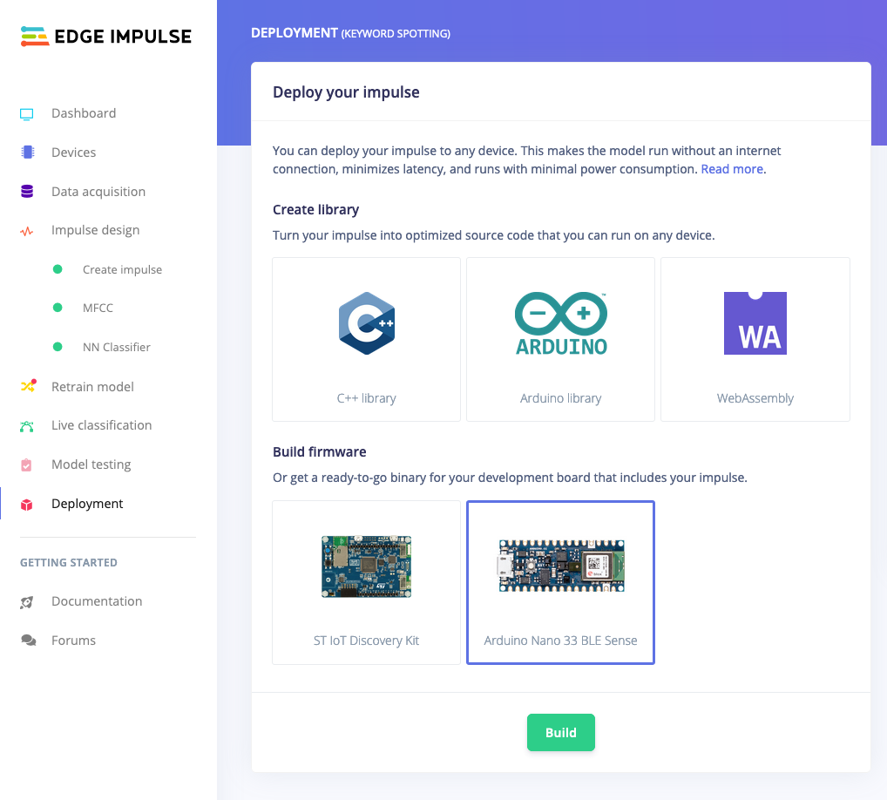
EDGE IMPULSE

